Slide 1
Smart Attend: RFID-Enabled Attendance System for Automated Employee or Student Tracking
PRAKASAM ENGINEERING COLLEGE
(App by AICTE, New Delhi & Affiliated to JNTUK, KAKINADA) Kandukur - OV Road ,523105, Nellore A.P.
GUIDED BY:
Mr. I. Rama Koteswara Rao, M. Tech
Associate Professor
SUBMITTED BY:
K. Srinadh - 21F91A04B0
S. Ganesh - 21F91A04C7
G. Parthasaradhi Reddy - 21F91A0478
R. Tharun - 21F91A04B8
Ch. Teja - 21F91A04B6

Slide 2
CONTENTS
OBJECTIVE
INTRODUCTION
REQUIREMENTS
BLOCK DIAGRAM
SCHEMATIC DESIGN
WORKING
ADVANTAGES AND DISADVANTAGES
APPLICATIONS
CONCLUSION

Slide 3
OBJECTIVE
Automatic attendance recording system that allows student to simply fill their attendance just by swiping or moving their ID card on RFID reader .
To monitor entry and exit time.

Slide 4
INTRODUCTION
In this project, we have designed RFID Based Attendance System using Arduino. EM-18 RFID Reader is a very simple yet effective module. It is an RFID module and is used for scanning RFID cards.
It’s a new technology and is expanding day by day. Nowadays it is extensively used in offices where employees are issued an RFID card and their attendance is marked when they touch their card to the RFID reader.

Slide 5
REQUIREMENTS
HARDWARE REQUIREMENTS :
ARDUINO UNO
RFID READER
16*2 LCD DISPLAY
LED & BUZZERS
SOFTWARE REQUIREMENTS :
PROTEUS 8
ARDUINO IDE

Slide 6
1. ARDUINO UNO
Arduino Uno is an open source microcontroller which its board based on micro chip AT mega 328p microcontroller and which is developed by Arduino.
This board is supplies sets of analog and digital input and output which may meet to various shield and other circuits. Radio Frequency Identification (RFID) is widely known as wireless non-contact use of radio waves which helps transfer in data.

Slide 7
2. RFID READER
EM-18 RFID reader is one of the commonly used RFID reader to read 125 KHz tags.
It features low cost, low power consumption, small form factor and easy to use.
The module radiates 125KHz through its coils and when a 125KHz passive RFID tag is brought into this field it will get energized from this field.
RFID CARD/ TAG – DATA CARRYING

Slide 8
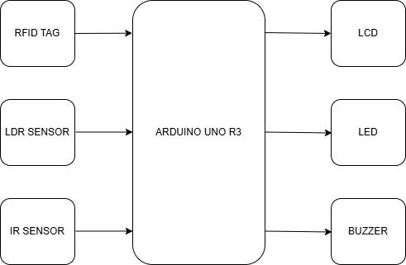
BLOCK DIAGRAM

Slide 9
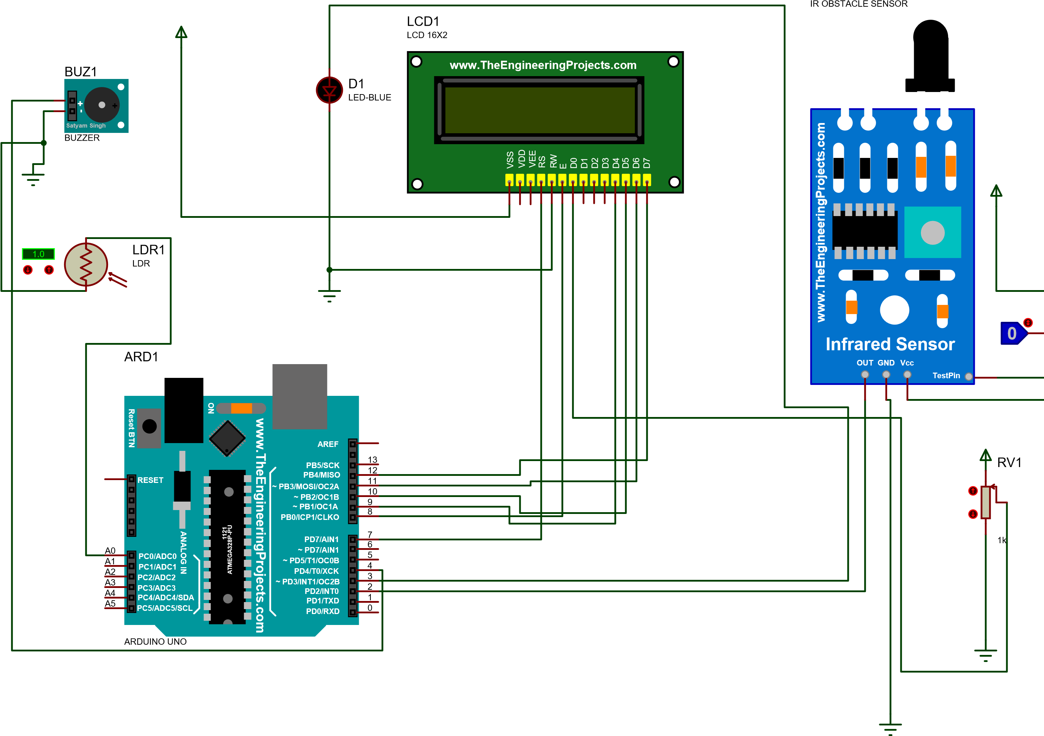
SCHEMATIC DESIGN

Slide 10
Working of RFID Based Attendance System using Arduino
In this project, we have designed an RFID based attendance system using Arduino. First, we store a set of RFID card data in our system. You can store any number of RFID data, but we have only stored 4 RFID tag numbers.
When the person with the correct RFID card comes & swipes his RFID card, his arrival time will be stored on the system displaying a “welcome“ message on LCD.
When the same person swipes his RFID card for the second time, the system will save it as his leaving time displaying “See You”. The interval between first card swap and second card swap is the total working hours that are stored as data.

Slide 11
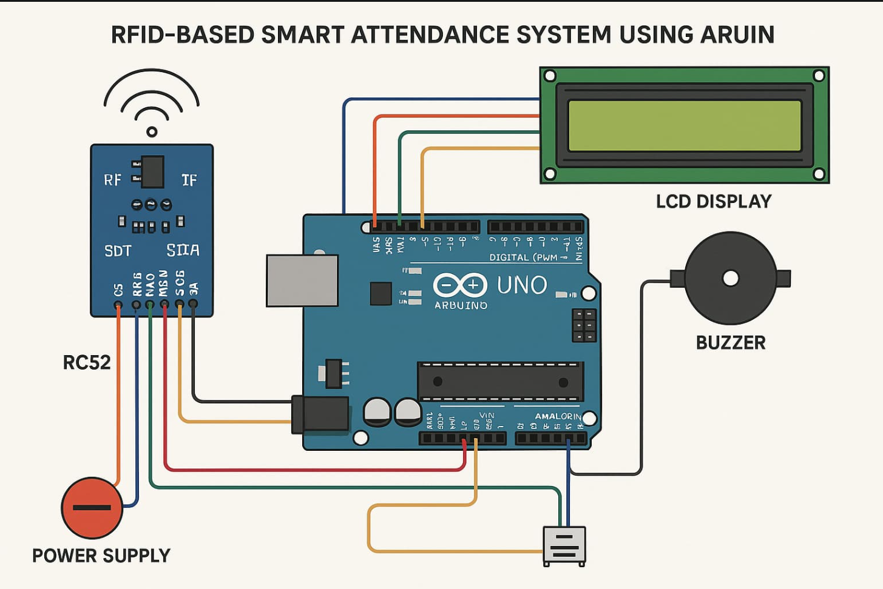
SIMULATION ON PROTEUS

Slide 12
ADVANTAGES
Fast and Contactless Attendance.
Accurate and Reliable
Low Power Consumption
Easy Integration
Scalable
Low Maintenance
Enhanced Security

Slide 13
DISADVANTAGES
Limited Range
No Built-in Storage
Tag Cloning Risk
Dependent on Power
Higher Initial Cost than Barcode Systems
Single-Card Scanning

Slide 14
APPLICATIONS
Educational Institutions
Corporate Offices
Hospitals & Healthcare Centers

Slide 15
CONCLUSION
The RFID-Based Smart Attendance System using EM-18 and Arduino Uno provides a fast, efficient, and contactless method for tracking attendance. It eliminates manual errors, reduces paperwork, and enhances security by allowing only authorized users to mark attendance. The system can be further improved by integrating Wi-Fi for cloud storage or GSM for remote access, making it a scalable and adaptable solution for various applications like schools, offices, and industries.

